Slide 1
Grouping Customers to Maximize Campaign Effectiveness
A Data-Driven Approach to Identifying the Best Clients
Presented by: Apostolis, Nikos, Maria

Slide 2
Why? Problem Statement
The marketing department has tasked our data science team with identifying groups of customers based on their characteristics and behaviors.
The goal is to determine the most profitable customer segment,
enabling the marketing team to design a highly targeted campaign that focuses on the best clients.

Slide 3
Importance of Customer Segmentation
Understanding Our Customers: To design effective marketing strategies, we need a clear picture of who our customers are.
Defining the Best Customers
Understand Customer Behavior: Spot patterns in spending, preferences, and engagement.
Optimize Resources: Prioritize high-value segments over others.
Drive Personalization: Create tailored campaigns for maximum impact.

Slide 4
How Did We Approach This?
Data Source: Customer Personality Analysis dataset from 2012 to 2014 (given from marketing team).
Steps Taken:
Data Cleaning: Removed missing values, handled outliers, normalized numerical features.
Exploratory Data Analysis (EDA):
Investigated relationships between spending habits, demographics, and income levels.
Visualized distributions and correlations to identify key drivers of profitability.

Slide 5
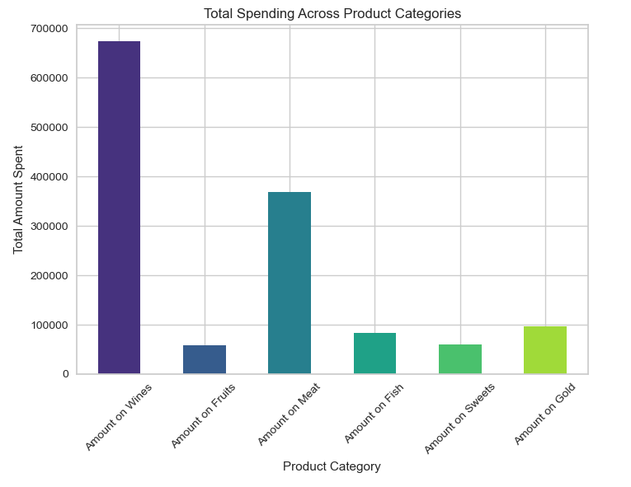
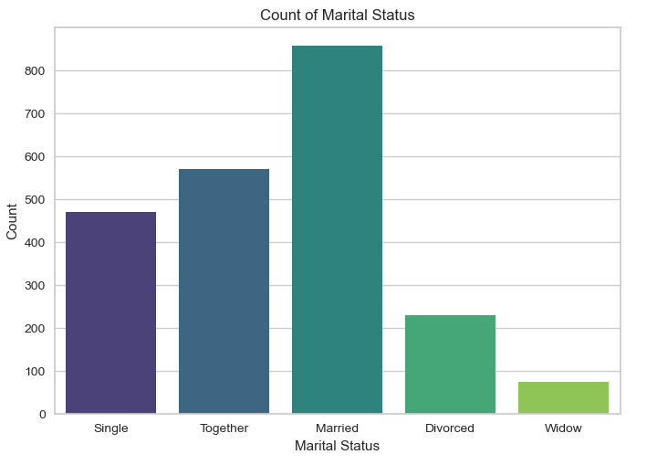
Exploratory Data Analysis Graphs

Slide 6
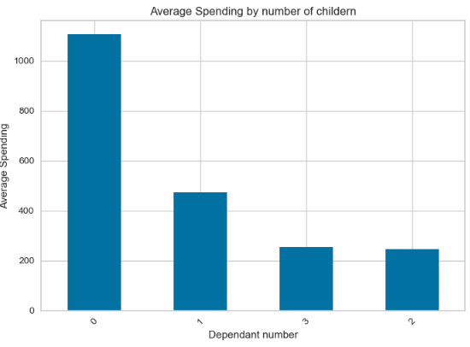
Exploratory Data Analysis Graphs

Slide 7
How Did We Approach This?
Focused on attributes like:
Income
Children
Age
Marital Status
Product
Engagement in campaigns

Slide 8
Choosing the Right Method
Since it is a clustering problem we tried lots of different methods (more than 10 different algorithms and parameters combinations) and concluded that Kmeans is our best option.
Scalability: Efficient for large datasets like ours.
Simplicity: Easy to interpret and deploy in future analyses.
Performance: Suitable for identifying well-defined groups.
How It Works:
Divides customers into k clusters based on similarities in features.
Each customer belongs to the group closest to their profile.

Slide 9
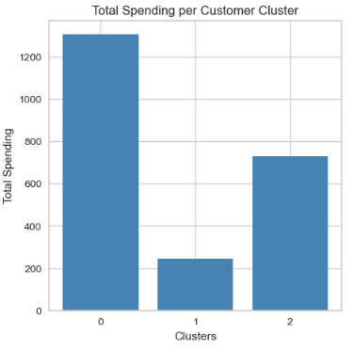
What Did We Discover? Results of Clustering
Clusters profiles:
Cluster 0: No kids - High Spenders
Cluster 1 - Low income, big families
Cluster 2 - Medium Income - Small families

Slide 10
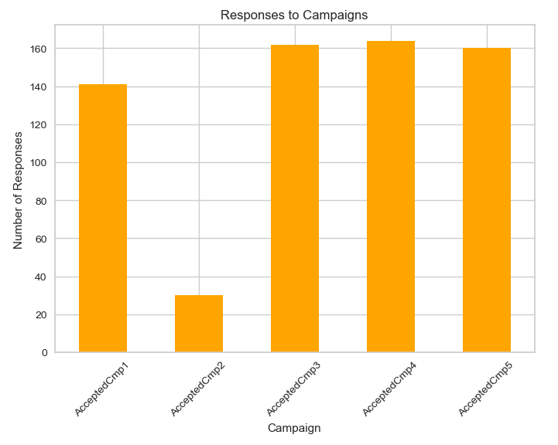
Recommended Campaign Strategy - Cluster focused campaigns
Current strategy: Generic. Very low conversion
Refined strategy: Cluster focused.
Personalized campaigns depending on customer profile, to improve campaign response, increase loyalty and maximize revenue.
From the graph you can see that almost no campaign had any viral success.

Slide 11
Next Steps- From Insight to Action
Actions for Marketing:
Evaluate Cluster Performance of targeted marketing campaigns
For Data Science Team:
Monitor campaign performance and refine segmentation.

Slide 12
Thank you!

